Slide 1
Point to Point Protocol

Slide 2
PPP Features
PPP was devised by IETF (Internet Engineering Task Force) to create a data link protocol for point to point lines that can solve all the problems
PPP is most commonly used data link protocol. It is used to connect the Home PC to the server of ISP via a modem.

Slide 3
PPP Features
This protocol offers several facilities
PPP defines the format of the frame to be exchanged between the devices.
It defines link control protocol (LCP) for:-
(a) Establishing the link between two devices.
(b) Maintaining this established link.
(c) Configuring this link.
(d) Terminating this link after the transfer.
It defines how network layer are encapsulated in a data link frame.
PPP provides error detection.
PPP supports multiple protocols.
PPP allows the IP address to be assigned at the connection time i.e. dynamically. Thus a temporary IP address can be assigned to each host.
PPP provides multiple network layer services supporting a variety of network layer protocol.
It also defines how two devices can authenticate each other.

Slide 4

Flag field: Flag field marks the beginning and end of the PPP frame. Flag byte is 01111110. (1 byte).
2. Address field: This field is of 1 byte and is always 11111111. This address is the broadcast address i.e. all the stations accept this frame.
3. Control field: This field is also of 1 byte. This field uses the format of the U-frame (unnumbered) in HDLC. The value is always 00000011 to show that the frame does not contain any sequence numbers and there is no flow control or error control.
4. Protocol field: This field specifies the kind of packet in the data field i.e. what is being carried in data field.
5. Data field: Its length is variable. If the length is not negotiated using LCP during line set up, a default length of 1500 bytes is used. It carries user data or other information
FCS field: The frame checks sequence. It is either of 2 bytes or 4 bytes. It contains the checksum.

Slide 5
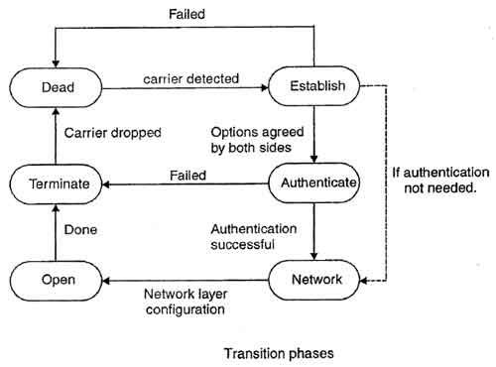
Transition phase in PPP
1. Dead: In dead phase the link is not used. There is no active carrier and the line is quiet.
2. Establish: Connection goes into this phase when one of the nodes start communication. In this phase, two parties negotiate the options. If negotiation is successful, the system goes into authentication phase or directly to networking phase. LCP packets are used for this purpose.
3. Authenticate: This phase is optional. The two nodes may decide during the establishment phase, not to skip this phase. However if they decide to proceed with authentication, they send several authentication packets. If the result is successful, the connection goes to the networking phase; otherwise, it goes to the termination phase.
4. Network: In network phase, negotiation for the network layer protocols takes place. PPP specifies that two nodes establish a network layer agreement before data at the network layer can be exchanged. This is because PPP supports several protocols at network layer. If a node is running multiple protocols simultaneously at the network layer, the receiving node needs to know which protocol will receive the data.
5. Open: In this phase, data transfer takes place. The connection remains in this phase until one of the endpoints wants to end the connection.
6. Terminate: In this phase connection is terminated.

Slide 6
Point-to-point protocol Stack
PPP uses several other protocols to establish link, authenticate users and to carry the network layer data.
The various protocols used are:
1. Link Control Protocol
2. Authentication Protocol
3. Network Control Protocol

Slide 7
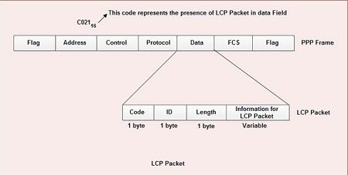
LINK CONTROL PROTOCOL
It is responsible for establishing, maintaining, configuring and terminating the link.
• It provides negotiation mechanism to set options between two endpoints.
All LCP packets are carried in the data field of the PPP frame.
• The presence of a value C021₁₆ in the protocol field of PPP frame indicates that LCP packet is present in the data field.
• The various fields present in LCP packet are:
1. Code: 1 byte-specifies the type of LCP packet.
2. ID: 1 byte-holds a value used to match a request with the reply.
3. Length: 2 byte-specifies the length of entire LCP packet.
4. Information: Contains extra information required for some LCP packet.

Slide 8
LCP Packets
• There are eleven different type of LCP packets. These are categorized in three groups:
1. Configuration packet: These are used to negotiate options between the two ends. For example: configure-request, configure-ack, configure-nak, configure-reject are some configuration packets.
2. Link termination packets: These are used to disconnect the link between two end points. For example: terminate-request, terminate-ack, are some link termination packets.
3. Link monitoring and debugging packets: These are used to monitor and debug the links. For example: code-reject, protocol-reject, echo-request, echo-reply and discard-request are some link monitoring and debugging packets.

